Slide 1
Route Planner for
Practical
Ride-Sharing Applications
Richard Webb, Jake Kim, John Kim
Notes:
Quick Introduction - introduce ourselves and tell the audience about our project (Taxi Route Finder)

Slide 2
Outline
Introduction
Real-World Applications
Network
Decision Agent
Utilities
Yen’s Algorithm/Decision Process
Execution Sequence
Simulation / Debug Mode
Future Development
Questions
Notes:
Who’s going to talk about what ( John - Introduction,Decision Network) (Richard - Utilities- Execution Sequence) (Jake - Until the End)

Slide 3
Introduction
Route planner for practical ride sharing applications
Decision agent (driver) navigates through network of nodes to pick up and drop off passengers
Receives real-time updates on utility values for taking each route from 20 shortest routes calculated through Yen’s Algorithm
The goal is to maximize utility - (travel time, traffic conditions, pick-up passenger on route, etc.)
Simulation done on a map of Vancouver through OpenGL
Notes:
Receives real-time updates on various utility values (from road conditions, traffic time, gas (possibly), etc.)
The goal is to make a decision based on these assigned utility values and take a route that will maximize utility.
Utilizing decision theory and utility information we learned in class (different routes will get updates as the driver goes)

Slide 4
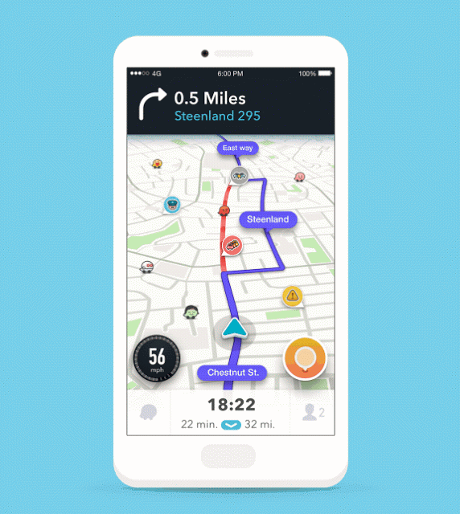
Real-World Applications
Real-time navigation system with constant updates (ex. Waze, Google Maps)
Implemented with autonomous driving on top of other applications
Transit services
Taxi services
Robot can navigate environment with known paths and goals, change utility of paths based on observed environment
Can be used in conjunction with pre-existing services (Lyft, Uber, Transit, Skip the Dishes, etc.)
Notes:
Similar to real-time navigation systems but specific for taxi services (or lyft, uber, etc.)
Doesn’t have to be implemented with taxi services, can also get real-time updates on paths to take for any consumer-ready autonomous driving
This code can be manipulated in a form to apply it to a robot navigation (search and rescue robot)

Slide 5
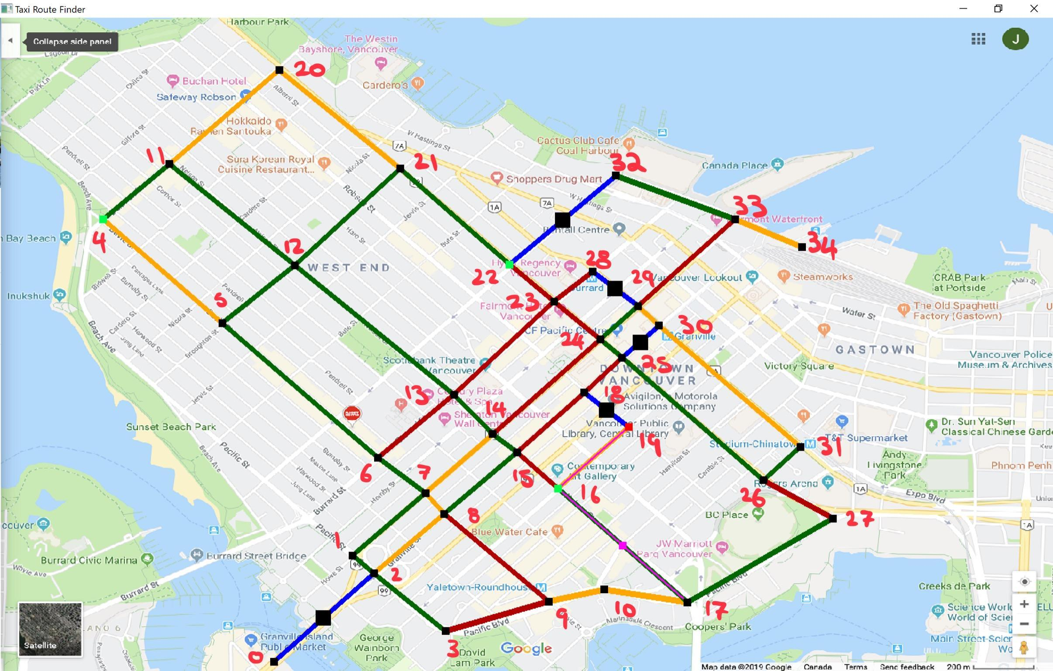
Network
Combination of bi-directional links between nodes to navigate our decision agent
Decision agent given information about nodes and links between them
Nodes: x and y coords, presence of passenger, destination, connected nodes, connected links
Links: start node, end node, distance, traffic information (markov chain), accident information (markov chain)
Traffic, accidents, passenger locations, and other dynamic road conditions recalculated every move the agent makes
Notes:
-Network is made of uni-directional and bi-directional links between nodes
-The decision agent will be given certain information about the network, and use that information to find the best route to transverse it to complete objectives
-nodes will be stored in an aray of structures, each structure contains information about the node such as its coordinates, if there is a passenger waiting at that node, if that node is a destination for a current pasenger, and the nodes and links that are connected to it. Could also have additional information if we decide to add additional road conditions later
-links wil be similar to nodes, storing information about each node in an array of link structures. They will have information on the start and end nodes , information on traffic of that node, (past values, mean, varience) accident information, and other information if we decide to implement additional features

Slide 6
Decision Agent
Given starting node in network, and list of destinations to visit in order (passengers pick ups, passenger drop offs, etc.)
Calculates the N Shortest Paths using Yen’s Algorithm
Properties of Agent: current node, current path, current passenger count (can hold up to 6), other possible properties (fuel, cargo space)
Calculates utility of each possible route based on knowledge available to it from the network’s nodes and links.
Notes:
Distance Utility - Yen’s Algorithm to find the shortest Path
Passenger and Destination Utility - Strongly correlated since the agent needs to decide whether to drop off or pick up passengers on the way while calculating the distances of each destination of passengers

Slide 7
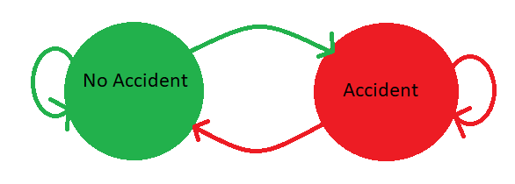
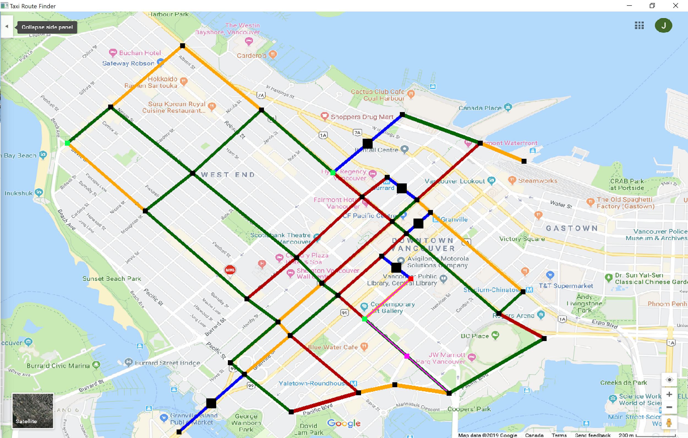
Accident Utilities
Accidents were calculated using two state markov chain change of states
No Accident - > Accident
No Accident - > No Accident
Accident -> Accident
Accident -> No Accident
Each links were given unique probabilities taking into account the part of the city and how busy it is
The accidents were represented by highlighting the link in blue and putting a large black point in the middle of the link
Notes:
-decision agent uses the probabilities and the current state of the link to calculate the probability that there will be an accident at this link when the decision agent need to cross it. -The probabilities of an accident for all links in a possible path are added together to get the total probability of encountering an accident on that path, and multiplied by -100 to give the accident probability of the path

Slide 8
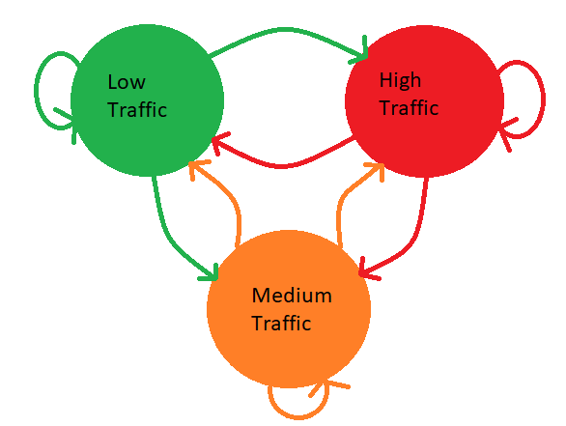
Traffic Utilities
Similar to the accident utility, traffic is calculated using a three state markov chain
Low Traffic - > Low Traffic
Low Traffic -> Medium Traffic
Low Traffic -> High Traffic
Realistic traffic conditions were taken into account for our markov probability
The traffic conditions were highlighted with their respective colors:
Low Traffic: Green (10) [default distance]
Medium Traffic: Orange (30)
High Traffic: Red (60)
Notes:
-Initially all links are assigned low traffic.
-Each link is also assigned the probabilities of transitioning from one state to another, or staying at its current state.
-The decision agent can use these transition probabilities and the current state of the link to calculate the probability that the link will have high, low or medium traffic when it needs to cross that link.
The decision agent then multiplies these probabilities by a static weight, -60 for high traffic, -30 for medium traffic, and -10 for low traffic, and adds resulting products to assign that link a utility value. The sum of the utility values for all links in a possible path is multiplied by -1, and assigned as the traffic utility for that path.

Slide 9
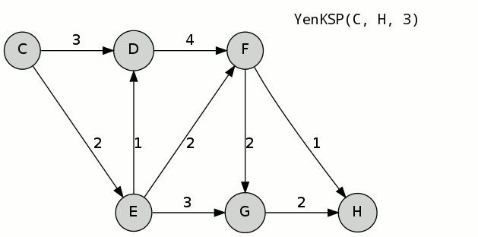
Yen’s Algorithm
Yen’s Algorithm is a way of finding the N number of shortest loopless paths in a nodal network
The function repeatedly finds the shortest paths using Dijkstra's algorithm but removing links from the shortest path to find the next shortest path

Slide 10
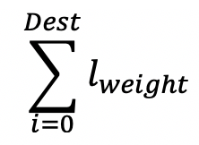
Decision Process
Given list of N possible paths from current node to destination node, ranked from shortest to longest from the static distances. Paths are found using Yen’s Algorithm.
Assign utility to path based on distance, possible traffic, passenger pick ups or destinations along the way, and accidents
Analyze all nodes and links in each path to determine its utility
Assign weights to each column, based on what decision agent wants to prioritize
Calculate total utility of paths and find best possible route
Route | Distance | Traffic | Passenger | Destination | Accident
1 |  | High / Medium / Low | T/F - if True at Node # | Node # | T/F
2 |  | High / Medium / Low | T/F - if True at Node # | Node # | T/F
... |  | High / Medium / Low | T/F - if True at Node # | Node # | T/F
20 |  | High / Medium / Low | T/F - if True at Node # | Node # | T/F
Notes:
Distance: travel distance
Traffic: random value each time, have to consider probability of high/low traffic of each link, over time as historic data is collected get a better idea of probability
Passenger: Can the agent pick up additional passengers on the way to current destination? Does it have room? If it hits destination before pick up
Destinations: Can the agent drop off a passenger on the way?
Other utility: probability of there being an accident, and additional features we decide to add
What prioritize? Want to prioritize paths with more passengers or destinations? Is it more important to drop off current passenger first? Weights could change based on state of agent (fuller cab, less important to pick up passengers, more important to drop off)

Slide 11
Execution Sequence
Initialize static network and agent, visualize in OpenGL
Calculate dynamic parameters of network (passengers, traffic, etc.)
Add new destinations to list of destinations
Find N shortest paths from agents current node to chosen destination node (Yens algorithm)
Assign utility to each path, make a decision for path to follow using weighted decision algorithm
Move to next node in the current path
If current node is a destination, update relevant values and lists(drop off/pick up passenger)
Repeat steps 2-8
Notes:
Yens algorithm is a way of finding the N shortest loopless paths in a nodal network. Works by repeatedly using a shortest path algorithm such as Dijkstra's algorithm, but removing links from the shortest path to find the next shortest

Slide 12
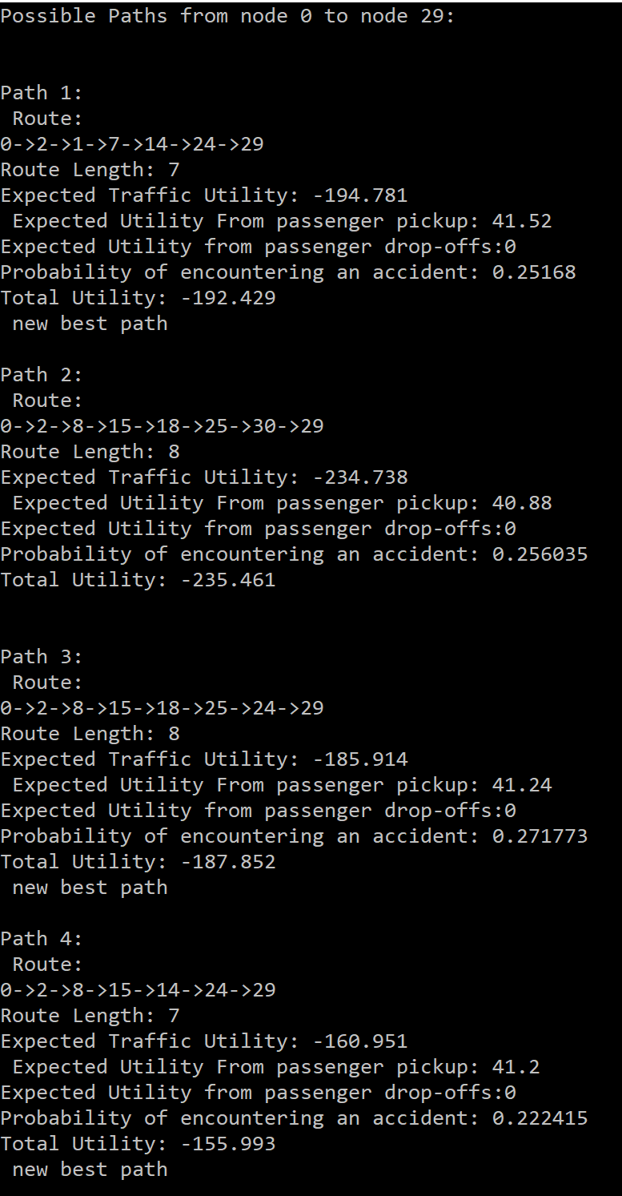
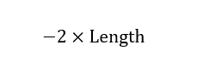
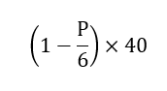
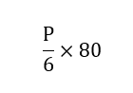
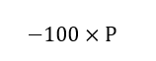
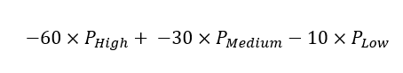
Debug Mode Execution
The user has the option to see the decision making process of the decision agent for each path option and the calculated utility
When the user presses enter, the decision agent will move to the next node and output the possible paths from the recalculated utilities
Utility | Distance | Traffic | Passenger | Destination | Accident
Weights

Slide 13
Simulation

Slide 14
Future Development
Refueling node: Decision agent can only go a set distance (static values) before it must refuel at a refueling node.
Rush Hour: By keeping track of execution time, we can increase traffic of some links at certain times. Agent must take the time into consideration when analyzing traffic of upcoming links in path
Multiple Decision Agents: Modify code so that multiple decision agents can navigate the network simultaneously, while coordinating passenger pick-ups and drop-offs with other agents. Different decision agents can have different priorities set by weights.
Notes:
Refuel when certain distance is exceeded (static) does not count traffic utility. Can stop by even if he has passengers.
Implement a clock or count of something, incrementer ( use execution time to increase traffic )
We can prioritize different things for each decision agent depending on their utility values
For example, we can set one of the agent taking shortest path and one that always picks up passengers before they head to the destinations...etc.

Slide 15

Questions?

